Slide 1







PIN - PeNG

Slide 2





CONTENTS

Slide 3

CHANGE
Scope-The supported online store :
large & popular B2C shopping websites
Depending on the time：
Small shops of Taobao is under consideration
Notes:
made a change/Huge Numbers of/Vary in the type & size/times is flush.

Slide 4
CONTENTS

Slide 5
Final Objectives
Users — Students in Siping &Jiading campus of Tongji Univ
Help users know the hot Sale Events(优惠活动) in time, to avoid miss the opportunities to save
Help users search the shopping partner broadly, specifically, most preferentially(优惠)
Help users reduce waiting time with high efficiency and high success rate
Help users avoid blind-consumption (盲目消费)
Notes:
underload

Slide 6
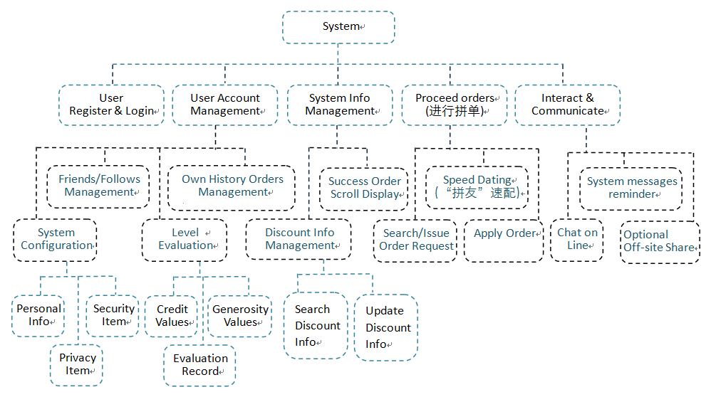
System Architecture
Notes:
underload

Slide 7
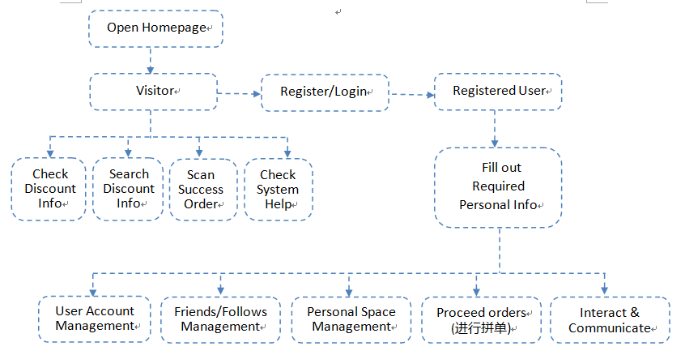
Overall Flow
Notes:
register

Slide 8
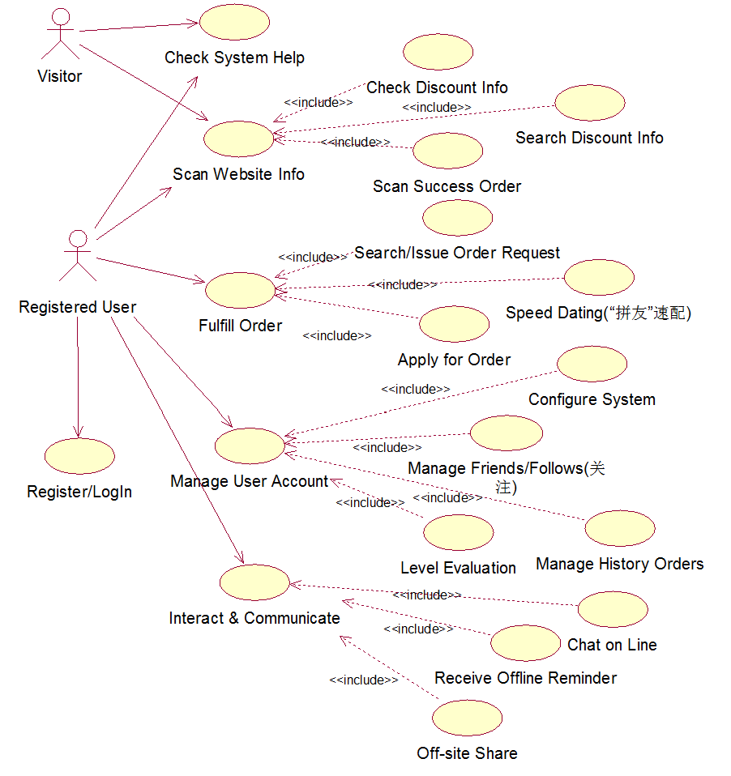
Use Case Model

Slide 9
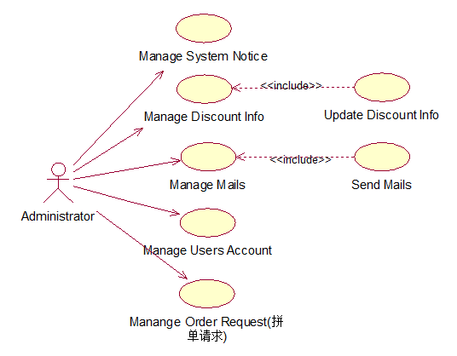
Use Case Model

Slide 10
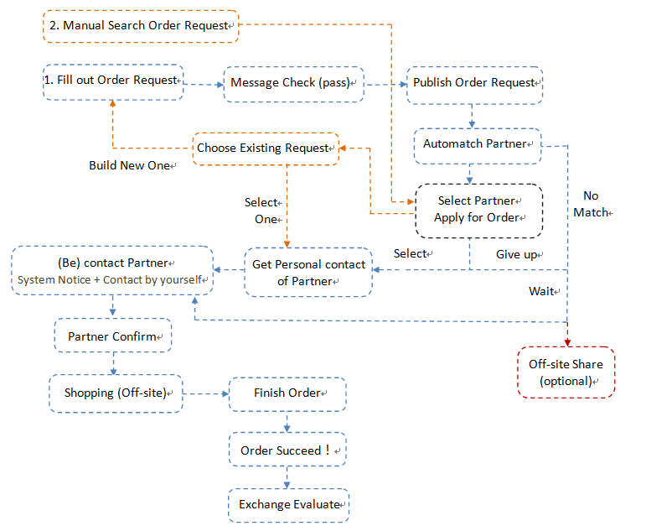
Ordering Flow

Slide 11
Ordering Flow
About Request Item:
Shopping store
Shopping money
Max partner member
Max waiting Days
Optional Payment method
Optional Notice method
…

Slide 12
Ordering Flow
About Search Item:
Shopping store
Shopping Amount Range
Gender
Payment method…

Slide 13
Ordering Flow
About Match Standard :
Discount
Dormitory
Credit Values
Generosity Values …
Priority Level = Weighted Average of parameters
Display Top-ten in detail

Slide 14
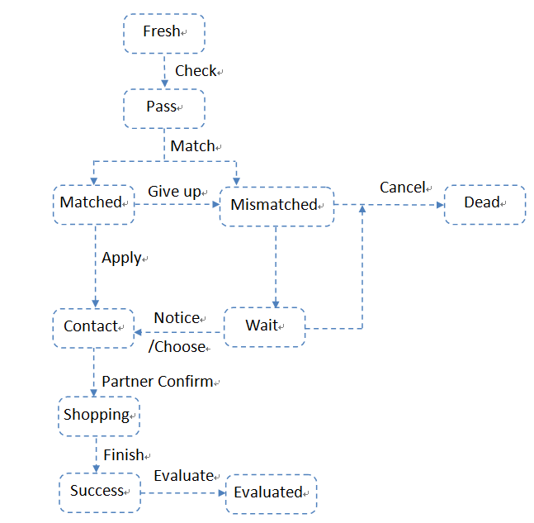
Order status

Slide 15
Non functional Requirement
1.Precision
Shopping order Money ：accurate to 0.01 Yuan
Discount Money：accurate to 1 Yuan
Time： accurate to 1 second
Input, Transmit, Store, Output need to be consistent
Notes:
underload

Slide 16
Non functional Requirement
2. Property
Secure: Account
Extendible: Function
Maintainable
3. Friendly Interface
Notes:
underload

Slide 17
Thank
you

